Slide 1
Developing Integration Solutions using Microsoft BizTalk Server 2013
BizTalk360

Slide 2

Course Outline
Module 1: Introduction to BizTalk Server
Module 2: Schemas
Module 3: Maps
Module 4: Testing and Deploying BizTalk projects
Module 5: Pipelines
Module 6: Routing
Module 7: Adapters
Module 8: Web Services and WCF
Module 9: Introduction to Orchestrations
Module 10: Applied Orchestration Techniques
Module 11: Business Activity Monitoring
Module 12: Business Rules
Module 13: Deploying and Managing Applications
Module 14: BizTalk360
Lesson 1: Introduction to BizTalk360
Lesson 2: BizTalk360 Key Features

Slide 3
Lesson 1: Introduction
What is a BizTalk360?
What areas does BizTalk360 cover?
Why use BizTalk360?

Slide 4
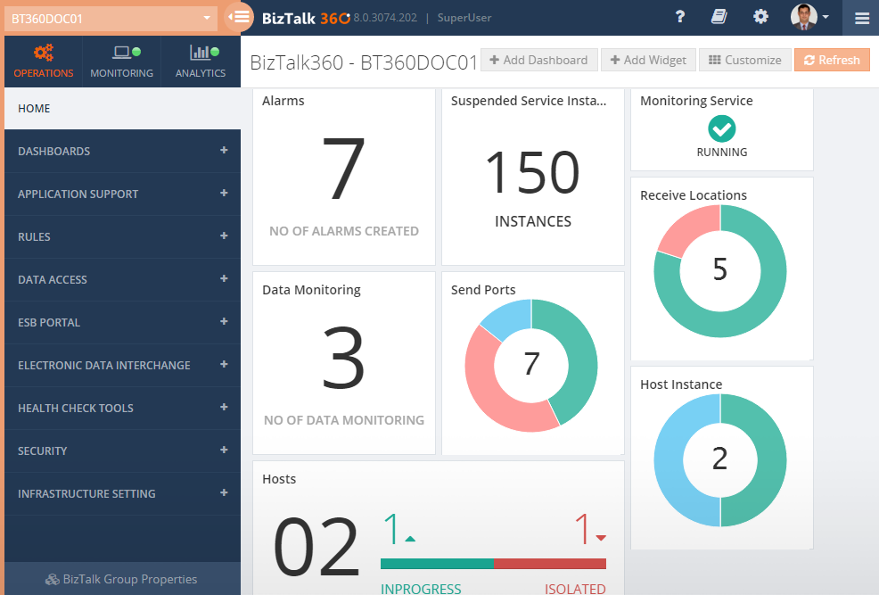
What is BizTalk 360?
-“The single platform to have total control over your BizTalk Server environment”
-”An efficient way to manage and monitor your BizTalk Environments”
Operations
Monitoring
Analytics
Notes:
Eftersom ett WF endast är data, så kan vi välja att skriva en egen deserilalizer.

Slide 5
Standard tools for operations
BizTalk Administration Console
BizTalk 360
Multi purpose
Used for both development, configuration, administration and operations.
Not designed with operations in mind
Very Powerful
Need a level of understanding to use it
Too powerful?
No access control, no audit
Anyone with access to the console can do anything to the environment
No web access
No dashboards or graphical tools
Single purpose is operations
Designed with day to day operations in mind
Easy to use
No deep BizTalk knowledge needed
Customizable Restrictions
Access control and audit
Right access for different stakeholders with full audit and governance of activities
Web access
Multiple customizable dashboards
Different graphical tools for easy overview
Notes:
Eftersom ett WF endast är data, så kan vi välja att skriva en egen deserilalizer.

Slide 6
Standard tools for Monitoring
SCOM, OP5 Monitor, IBM Tivoli Monitor, HP OpenView etc
Complex, extensive and powerful products
Struggle to configure correctly
Struggle to find correct thresholds and behaviors for alerts and reporting
Need expertise on the products to use them correctly
Normally the monitoring experts aren’t familiar with BizTalk and vice versa
Not built specifically for BizTalk
Mostly for Server monitoring
Extended with plugins etc to make it work
BizTalk 360
Easy to use
Easy to set up monitoring and alerts
Built in notification channels
Export/Import configuration between environments
Specifically built for BizTalk
Most challenges that arise in BizTalk monitoring thought of from the beginning
2 different specific monitoring dashboards for different needs updated in real time
Notes:
Eftersom ett WF endast är data, så kan vi välja att skriva en egen deserilalizer.

Slide 7
Standard tools for Analytics
Perfmon, PAL, BizTalk Health Monitor, BizTalk Benchmark Wizard
A lot of different tools to keep track of
Knowledge about each product needed to use them correctly
Need a level of understanding on BizTalk analytics to get the answers you want
What am I looking for?
What values are good and bad?
BizTalk 360
One tool to visualize interesting facts and environment health
Customizable for specific needs
Tells you what’s interesting based on standard BizTalk performance counters and databases
Tells you how your environment are doing based on standard BizTalk performance counters and databases
Notes:
Eftersom ett WF endast är data, så kan vi välja att skriva en egen deserilalizer.

Slide 8
Why BizTalk360?
Specifically built for BizTalk
Customizable for different needs
Secure, Access controlled and audits user activities
Easy to configure, manage and get the right information from the right sources
A lot of functionality built into one
Notes:
Eftersom ett WF endast är data, så kan vi välja att skriva en egen deserilalizer.

Slide 9
Lesson 2: Key Features
Operations
Monitoring
Analytics
Extra

Slide 10
Operations
Dashboard
Customizable
Reflect your own unique reality
A lot of out of box widgets
Bring in data from external sources
Multiple dashboards for multiple scenarios
Notes:
Eftersom ett WF endast är data, så kan vi välja att skriva en egen deserilalizer.

Slide 11
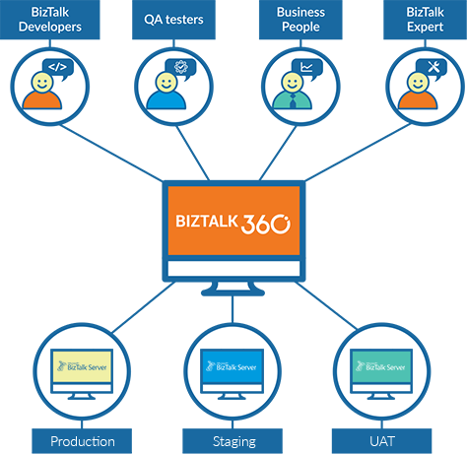
Operations
Security
A lot of different stakeholders
Different needs
Different level of access to different environments
Right amount of access for different people
Audit user activities
See who starts and stops ports, resumes messages etc
Access control
Read-only access
Access to different applications
Notes:
Eftersom ett WF endast är data, så kan vi välja att skriva en egen deserilalizer.

Slide 12
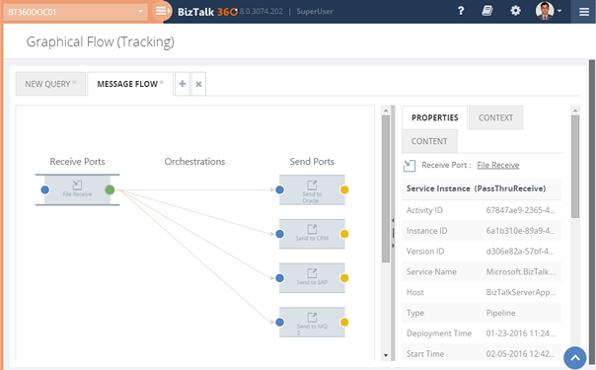
Operations
Visualization
Graphic visulization
Understand message flows
No development needed to take advantage of this
Notes:
Eftersom ett WF endast är data, så kan vi välja att skriva en egen deserilalizer.

Slide 13
Monitoring
BizTalk Artifacts
Alerts, notifications and automatic recovery
Receive locations, send ports, orchestrations, host instances
Easy setup and configuration
Non-Event alerts
Monitor for events that should occur in flexible time windows
Other Artifacts
Alerts and notifications
CPU/Memory, NT Services, SQL jobs, disk space, event logs, database queries, web endpoints etc.
Alerts on different thresholds
Configuration
Export/Import configuration between environments
Notes:
Eftersom ett WF endast är data, så kan vi välja att skriva en egen deserilalizer.

Slide 14
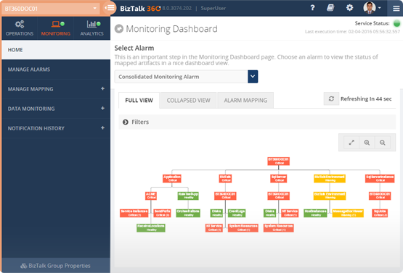
Monitoring
Notification channels
Out of box
Email, SMS, Event Viewer etc
Easy setup and configuration
SDK
Execute powershell, call rest endpoints etc on notifications or alerts.
Two different monitoring Dashboard
Hierarchical tree view
Updated in real time
Calendar view with drill down
Updated in real time
Notes:
Eftersom ett WF endast är data, så kan vi välja att skriva en egen deserilalizer.

Slide 15
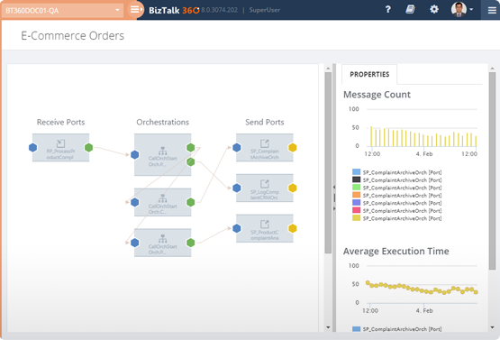
Analytics
Customizable dashboards
Customize the views for the analytics of you environment
Correlate metrics
Understand the environment health using the throttling analyser
Visualize messaging patterns
Notes:
Eftersom ett WF endast är data, så kan vi välja att skriva en egen deserilalizer.

Slide 16
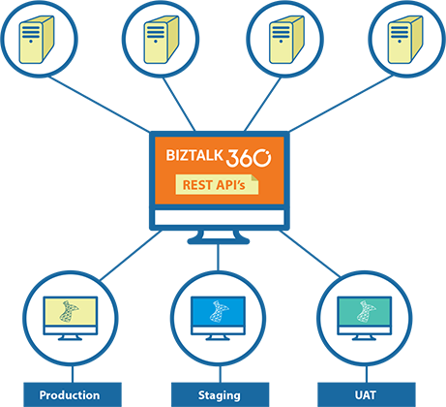
Extra
REST based API access for BizTalk Environments
350+ API to support operations, monitoring and analytics
Notes:
Eftersom ett WF endast är data, så kan vi välja att skriva en egen deserilalizer.

Slide 17
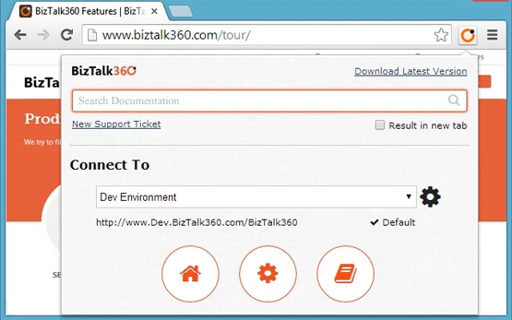
Extra
Chrome Extensions
Utility to access multiple BizTalk environments seamless
Notes:
Eftersom ett WF endast är data, så kan vi välja att skriva en egen deserilalizer.

Slide 18
Q & A
BizTalk 360

